Slide 1
Rickety, Rackety, React
Day 58

Slide 2
Component Refresher

Slide 3
A Moment to Ponder…
Instead of separating “layout and logic”, React JS uses what alternative paradigm?

Slide 4
A Moment to Ponder…
Instead of separating “layout and logic”, React JS uses what alternative paradigm?
Components*!
* If you only learn one thing from our lessons on React it should be this.

Slide 5
A Moment to Ponder…
What exactly are components again?

Slide 6
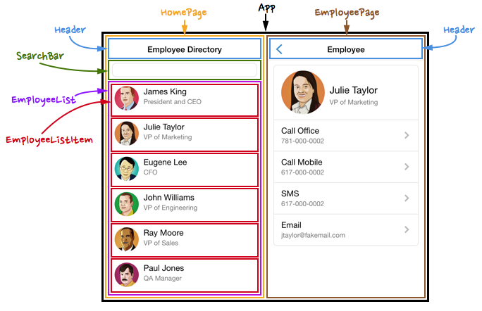
Power of Components!
By separating elements out into components...
Layout and Logic are kept bundled together in a self-contained package.
Components can easily be re-used in various points in the application without needing to be re-coded.
Components can be more easily tested. (i.e. having one re-usable component means only one UI element needs to be tested).
For complex applications each of these can be critical in finding bugs and saving time.
Power of Components!

Slide 7
A Moment to Ponder…
What method do we use to create a
new component?

Slide 8
A Moment to Ponder…
What method do we use to create a
new component?
var ClassName* = React.createClass()
* Remember that React components must be capitalized

Slide 9
A Moment to Ponder…
What method do we use to create a
render our components to the DOM?

Slide 10
A Moment to Ponder…
What method do we use to create a
render our components to the DOM?
ReactDOM.render()*
* Note that you will only be rendering a single component into the DOM. Every other component will be a child to that component.

Slide 11
A Moment to Ponder…
New Question:
Every component must contain which method?

Slide 12
A Moment to Ponder…
New Question:
Every component must contain which method?
render: function() { }*
* Our render function will define what our component will look like. It will be in JSX syntax

Slide 13
A Moment to Ponder…
New Question:
How do we deploy a component in our JSX?

Slide 14
A Moment to Ponder…
New Question:
How do we deploy a component in our JSX?
<ComponentName />

Slide 15
A Moment to Ponder…
New Question:
How would we deploy a component inside of another component?

Slide 16
A Moment to Ponder…
New Question:
How would we deploy a component inside of another component?
<ParentComponent>
<ComponentName />
</ParentComponent>

Slide 17
JSX Gotcha’s

Slide 18
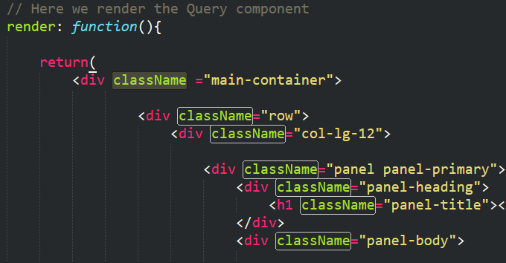
Incorporating Classes
It turns out…
You can incorporate classes into JSX
You just need to call them “className”
This is because “class” is a reserved keyword in Javascript

Slide 19

Incorporating Styles
It also turns out…
You can incorporate CSS styles into JSX
You just need to ditch the hyphen and camelcase the property.
Ex: font-size → fontSize

Slide 20
Component Architecting

Slide 21
Parent-Child Relationships
App.js
App.js
Header.js
Header.js
Search.js
Query.js
Search.js
Query.js
Results.js
Results.js
First step in building React applications is determining the component hierarchy.

Slide 22
Parent-Child Relationships
Main.js
Main.js
Search.js
Query.js
Search.js
Query.js
Results.js
Results.js
Sometimes, you can then simplify it by realizing certain components are static elements.

Slide 23
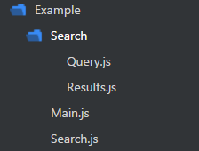
Parent-Child Relationships
Main.js
Search.js
Query.js
Results.js
You then code out your components to match the same hierarchy.

Slide 24
States and Props

Slide 25
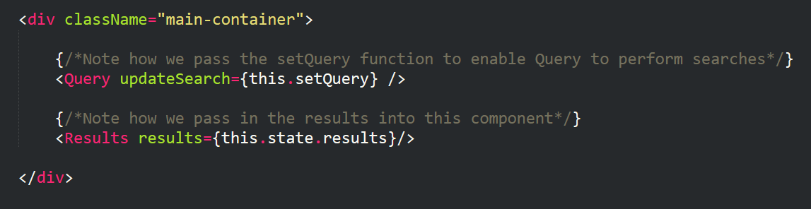
Passing State from Parent to Child
Parents can pass data (states and props) or methods to children. (It’s a bit trickier to send it to parents).

Slide 26
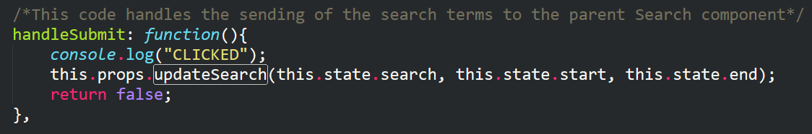
Children Inherit Props
When children inherit the data or method it ALWAYS comes in the form of a prop.
Props can be specifically referenced using this.props.propName syntax.

Slide 27
Props vs States: What’s the Difference?
States:
Mutable (i.e. changeable with UI).
States can be changed using this.setState({})
Props:
Immutable (i.e. unchangeable).
Props are static elements. They may be static properties or static methods.

Slide 28

A Moment to Ponder…
React.JS has a strong preference for passing state from parents to children…
What is the implication of this?

Slide 29
Unidirectional Data Flow

Slide 30
Unidirectional Data Flow
React.JS has a strong preference for unidirectional data flow.
This means that the variables that get manipulated are controlled by parents.
Parents are then responsible for divvying the data (and state changes) to the children.
Child A
GrandChild A
Great GrandChild A
Parent
Child B
GrandChild B
Great GrandChild B

Slide 31
Unidirectional Data Flow
Child A
GrandChild A
Great GrandChild A
Parent
Child B
GrandChild B
Great GrandChild B
“Oh Hey! My GrandChild A just changed colors”

Slide 32
Unidirectional Data Flow
Child A
GrandChild A
Great GrandChild A
Parent
Child B
GrandChild B
Great GrandChild B
“I’ll let the others know if needed….”

Slide 33
Unidirectional Data Flow
This approach is meant to create a level of manageability when it comes to data flow and UI changes.
Child A
GrandChild A
Great GrandChild A
Parent
Child B
GrandChild B
Great GrandChild B

Slide 34
Time to Code!

Slide 35
Questions

